Slide 1

Predictive Analytics
for
Retail Banking and Finance

Slide 2
What is RETAIL BANKING ?
Typical mass-market banking in which individual customers use local branches of larger commercial banks. Services offered include savings and checking accounts, mortgages, personal loans, debit/credit cards. The focus is on the customer.
The main challenges this sector are :
What is the suitable product to recommend to a customer ?
What is the best time to market the product ?
Which is the most effective channel to contact a customer ?

Slide 3
PROBLEM STATEMENT
In this problem, the data is related with direct marketing campaigns of a banking institution. The marketing campaigns were based on phone calls. Often, more than one contact to the same client was required, in order to access if the product (bank term deposit) would be ('yes') or not ('no’) subscribed. The goal is to predict if the client will subscribe a term deposit.

Slide 4
ABOUT DATASET
This is the classic marketing bank dataset uploaded originally in the UCI Machine Learning Repository. The dataset gives you information about a marketing campaign of a financial institution in which you will have to analyse in order to find ways to look for future strategies in order to improve future marketing campaigns for the bank.

Slide 5
Here are what the columns in the data set represent:
Age : Age of the client- (numeric)
Job : Client’s occupation - (categorical) (admin, blue-collar, entrepreneur, housemaid, management, retired, self employed, services, student, technician, unemployed, unknown)
Marital : Client’s marital status - (categorical) (divorced, married, single, unknown, note: divorced means divorced or widowed)
Education : Client’s education level - (categorical)
Default : Indicates if the client has credit in default - (categorical) (no, yes)
Balance :average yearly balance, in euros (numeric).
Housing : Does the client as a housing loan? - (categorical) (no, yes)
Loan : Does the client as a personal loan? - (categorical) (no, yes)
Contact : Type of communication contact - (categorical) (unknown, cellular, telephone)
Day : Day of last contact with client.
Month : Month of last contact with client - (categorical) (Jan - Dec)

Slide 6
Duration : Duration of last contact with client, in seconds - (numeric) For benchmark purposes only, and not reliable for predictive modelling.
Campaign : number of contacts performed during this campaign and for this client (numeric, includes last contact) - (numeric) (includes last contact)
Pdays : Number of days passed client was last contacted - (numeric) (-1 means client was not previously contacted)
Previous : Number of client contacts performed before this campaign - (numeric)
Poutcome : Previous marketing campaign outcome - (categorical)
Deposit : subscription verified. (output)

Slide 7
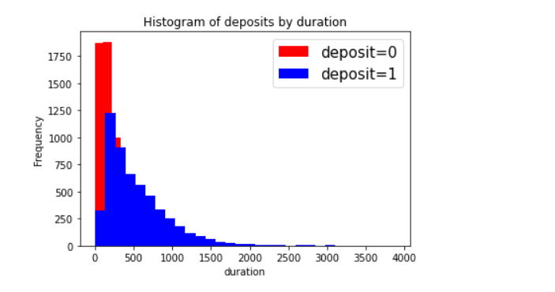
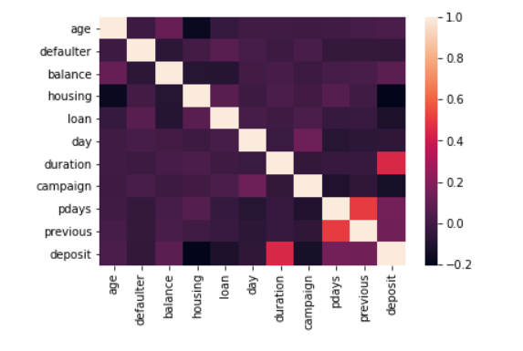
EXPLORATORY DATA ANALYSIS(EDA)
CORRELATION
USING
HEATMAP

Slide 8
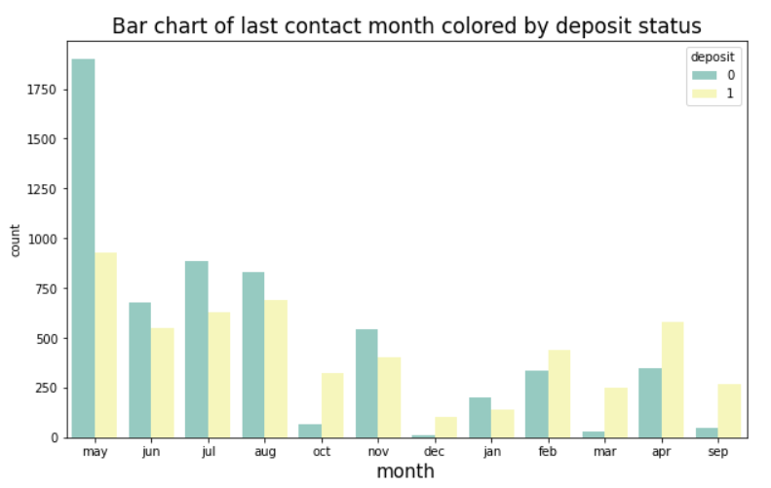
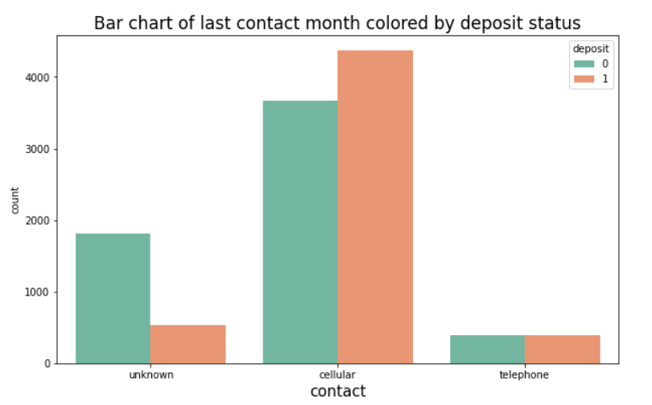

Slide 9
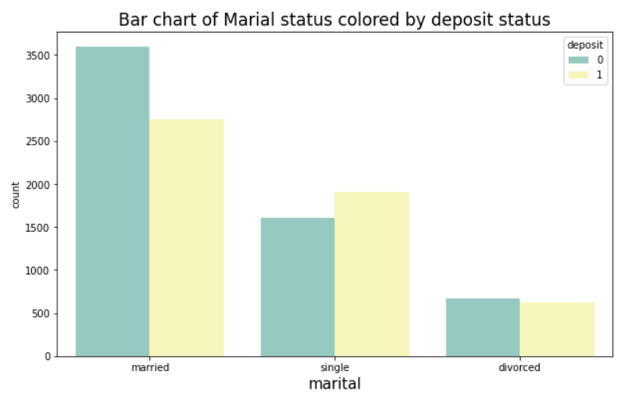
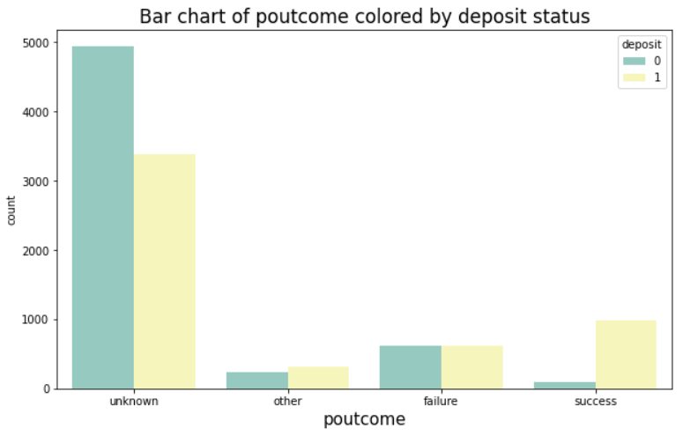

Slide 10
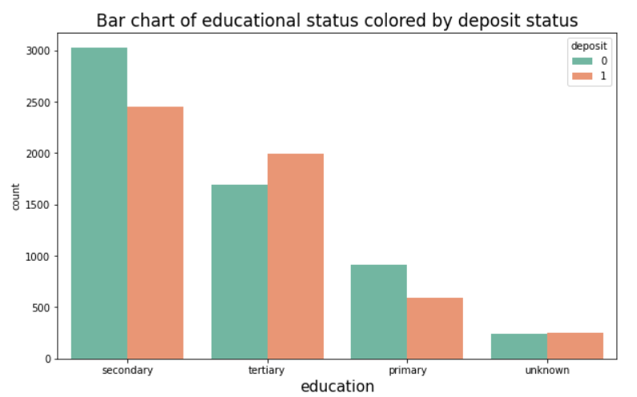
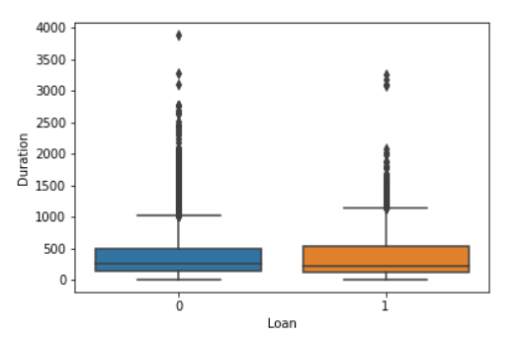
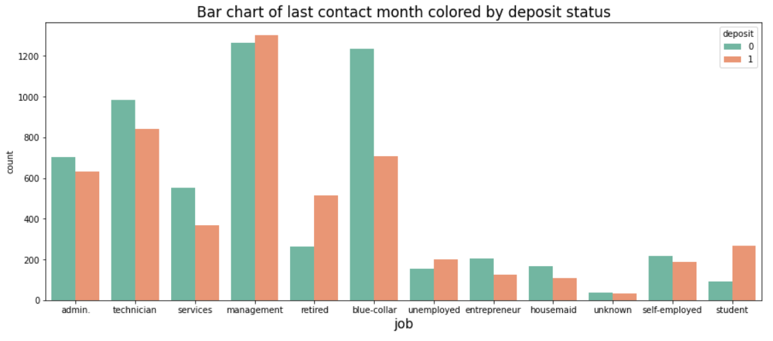

Slide 11
Model Selection
Why Min Max Scaler?
Max
Since the output variable is in 0’s and 1’s form, We need to scale down our feature variables to the range of 0 and 1
Min

Slide 12
Accuracies of All the models
Model Name | Accuracy in %
K-nearest Neighbour | 73.175101
Logistic Regression | 75.817286
Support Vector Classification | 73.578146
Random Forest Classifier | 76.265114
XG Boost Classifier | 84.191670

Slide 13
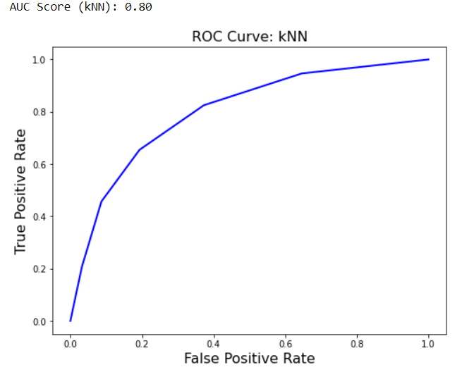
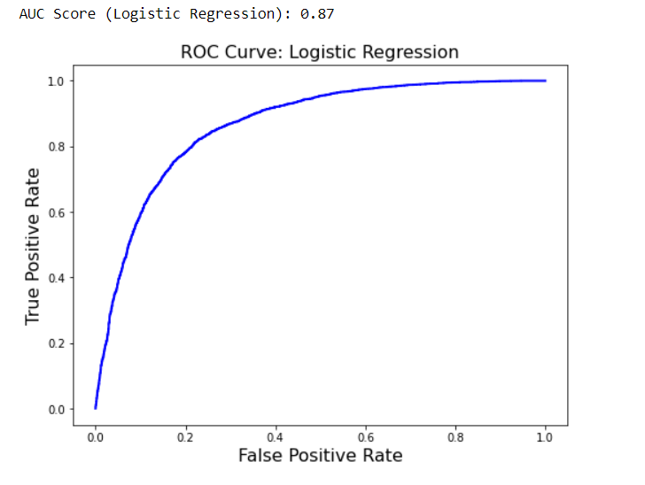
Graphs

Slide 14
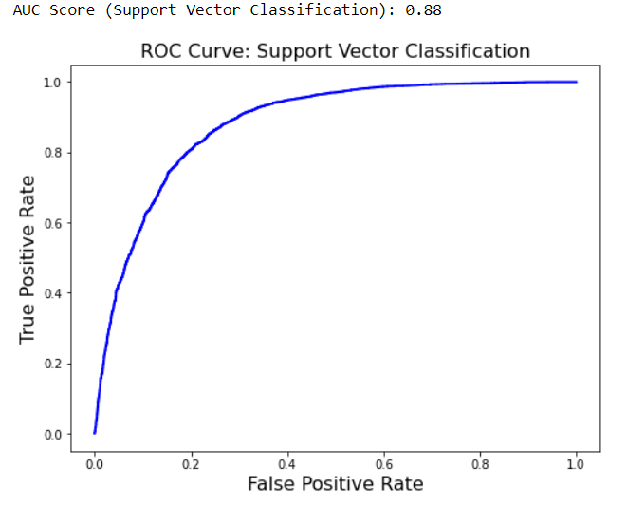
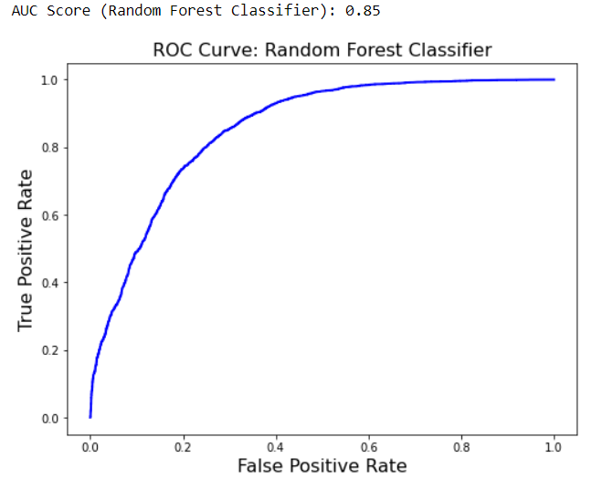

Slide 15
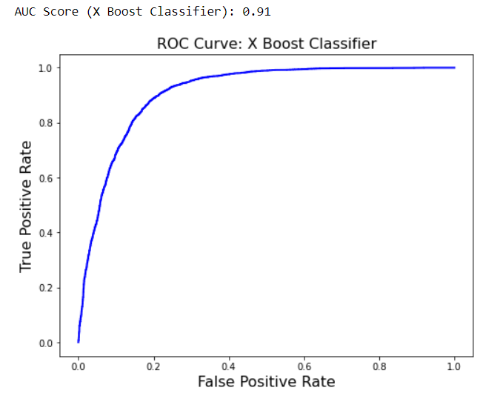

Slide 16
I CHOOSE
XGBOOST CLASSIFIER
Accuracy = 84.191670 %

Slide 17
CONCLUSION
Most classification problems in the real world are imbalanced. Also, almost always data sets have missing values. In this post, we covered strategies to deal with both missing values and imbalanced data sets. We also explored different ways of building ensembles in sklearn. Below are some takeaway points:
Sometimes we may be willing to give up some improvement to the model if that would increase the complexity much more than the percentage change in the improvement to the evaluation metrics.
Easy Ensemble usually performs better than any other resampling methods.

